Slide 1
Title is two lines, unless too long/short
TEMPLATE INSTRUCTIONS
Day, Mon XX | XXPM ET | XXPM PT
Livestream event

Slide 2
Title of Event
Wed, Mar 3 | 1PM ET | 4PM PT
Livestream event

Slide 3
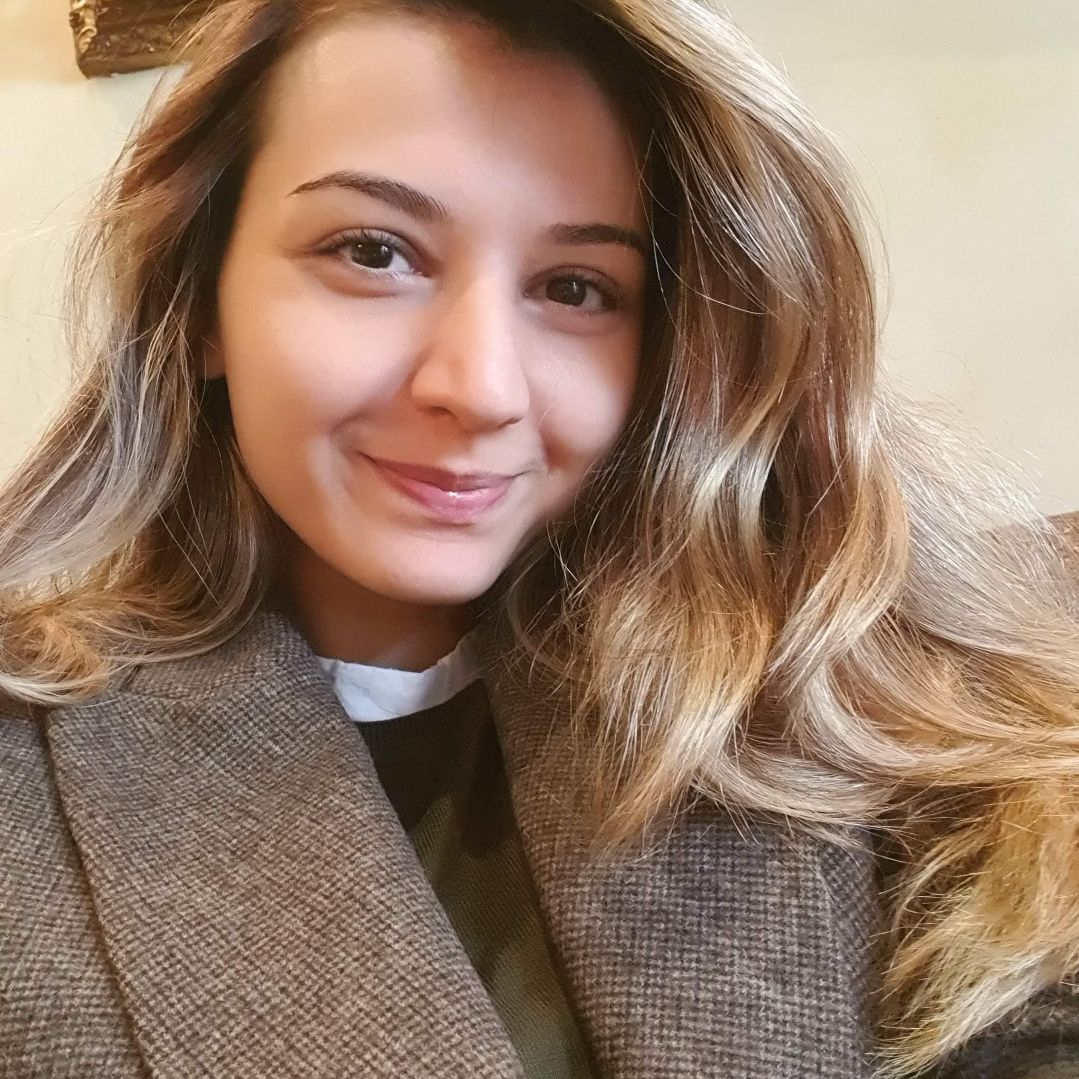
Title of Event
Wed, Mar 3 | 1PM ET | 4PM PT
Livestream event
Speaker Name
Speaker Title

Slide 4
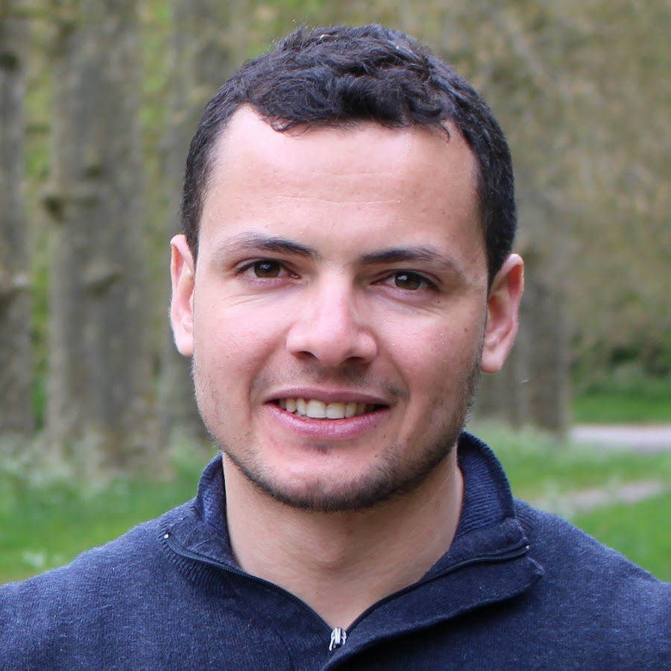
Title of Event
Wed, Mar 3 | 1PM ET | 4PM PT
Livestream event
Speaker Name
Speaker Name
Speaker Title
Speaker Title

Slide 5
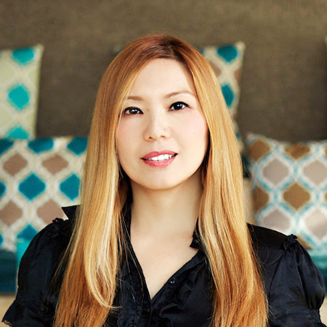
Converting PowerShell Scripts to use Graph API
Wed, Nov 17 | 17:00 – 18:00 (India Standard Time)
Livestream event
Chendrayan Venkatesan
(Speaker)
Rohit Yadav
(Moderator)
Arpita Das
(Moderator)
Microsoft Most Valuable Professional
Gold Microsoft Learn Student Ambassador
Gold Microsoft Learn Student Ambassador

Slide 6
Conversation Prompt:

Slide 7
Community Standards
Be aware of others
Be friendly and patient
Be welcoming and respectful
Be open to all questions and viewpoints
Be understanding of differences
Be kind and considerate to others
You can raise an anonymous concern via the Microsoft Runs on Trust website.

